Slide 1

“Virtual Password System”
Department of Computer Science and Engineering
Engineering College Ajmer
Mentor : Mr. Avinash Bhandiya Sir

Slide 2

Virtual Password System – Project Architecture & Technologies
This presentation outlines the architecture and technologies behind our Virtual Password System project. We will cover all about the Virtual Password System. Join us to explore the building blocks of Virtual Password System.

Slide 3
TEAM MEMBERS
Tanushree Yadav (22EEACY051) - (Team Leader)
Piyush Sharma (22EEACY036)
Pradeep Lora (22EEACY037)
Tanmay Yadav (22EEACY050)
Tarun Kumar Narnoliya (22EEACY052)

Slide 4

Overview :
Virtual Password System
The Virtual Password System is designed to provide military-grade security for user authentication through a unique PIN-based system.
Its primary purposes are:
Enhanced Security
Cryptographic Protection
User Convenience
Admin oversight
Phishing Prevention

Slide 5
Enhanced Security: Replace traditional password-only systems with a two-factor authentication approach.
Cryptographic Protection: Ensure user credentials are never stored in plain text.
User Convenience: Eliminate the need to remember complex passwords.
Admin Oversight: Provide administrators with tools to manage user access securely.
Phishing Prevention: Protect against credential theft through dynamic PIN generation.

Slide 6
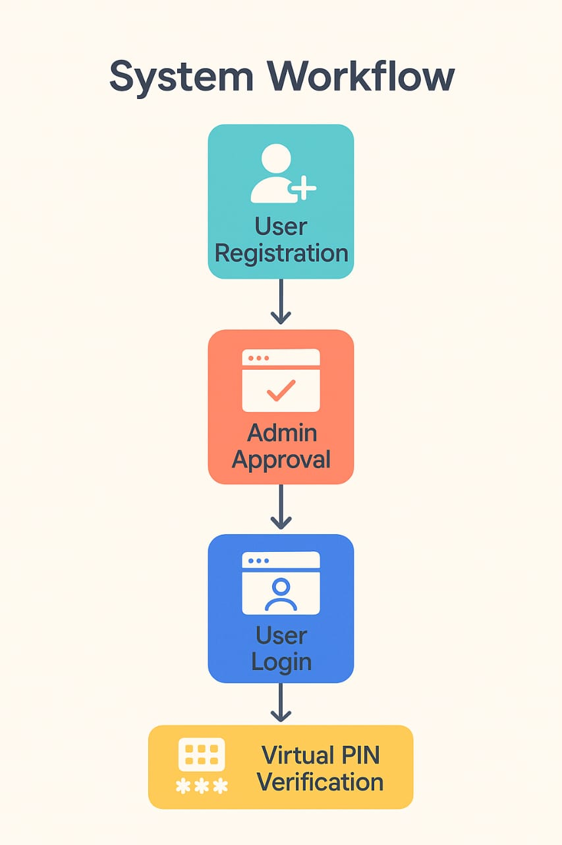
How the system works :
User Registration:
Users provide personal details and create a password
System checks password strength and ensures username uniqueness
Registration details are stored locally with "pending" status
Admin Approval:
Administrator reviews and approves new registrations
Upon approval, the system generates a virtual PIN based on the user's password
PIN is securely emailed to both user and admin
User Login Process :
User enters credentials (username/password)
System verifies credentials against stored data
User is prompted to enter the virtual PIN sent to their email
Upon successful PIN verification, access is granted
PIN Verification :
PIN is valid only for the current session
Users can request PIN resend if needed
Incorrect PIN entries trigger security alerts

Slide 7
🔒 Key features :
Military-Grade Security :
Cryptographic hashing with salt and pepper
Key stretching (1000 iterations)
Virtual PIN regeneration on each approval
Secure Email Delivery :
Encrypted email communication
PIN delivery to both user and admin
Email verification for all critical actions
Admin Dashboard :
User management interface
Approval workflow for new registrations
Statistics dashboard (total users, pending approvals, active users)
Data export functionality
Password Strength System :
Visual password strength indicator
Real-time validation (length, complexity)
Confirmation checks
Responsive Design :
Mobile-friendly interface
Adaptive layout for all devices
Touch-friendly controls

Slide 8

Security Protocols :
Data Encryption: All sensitive data is encrypted in local Storage.
Session manage-ment: Current user sessions are securely managed
Two-Factor Authentication: Password + PIN verification
Secure Communication: EmailJS with TLS encryption
No Plaintext Storage: Passwords are never stored in readable format

Slide 9

Technical Stack :
Frontend :
Frameworks
HTML5, CSS3, JavaScript (ES6)..
Bootstrap 5, Font Awesome.
Email :
EmailJS with TLS encryption.
Storage :
Browser local Storage.
Crypto :
Custom SHA-256 with salt and pepper.

Slide 10

Conclusion & Future Enhancements
Secure, user-friendly password system.
Protects against phishing and breaches.
Modern approach to digital identity protection.
Easy to deploy, with admin control.

Slide 11
THANK YOU !

